Slide 1

TITLE:MULTI - STORE GROCERY PRICE COMPARISION SYSTEM
Student Name: Shreenitha
Student ID: 2520030504
Cluster:4
Section: 14
Under the Guidance
of
Supervisor Name: Sreeram Murthy
Assistant Professor
Department of CSE

Slide 2
OUTLINE
Abstract
Existing System
Proposed System
System Architecture
Project Modules
Objectives
Co’s Attainments - FWD
Co1
Co2 …….. 5. Co5
Co’s Attainments - DSA
Co1
Co2 …….. 5. Co5
Screen Shots for FWD & DSA
Conclusion
Geo-Tagged Photos

Slide 3
Abstract
The Grocery Compare project is a web-based application designed to help users compare grocery prices across multiple nearby stores and select the most affordable option. The system displays a variety of grocery products along with their prices from different stores, allowing users to easily identify the best deals. Products are organized into categories such as vegetables, fruits, grains, dairy, and other daily essentials to make browsing simple and efficient.

Slide 4
The main objective of this project is to simplify grocery shopping using data structures and algorithms for efficient price comparison. In this system, arrays and objects are used to store product details, while searching and filtering techniques help users find items quickly. The project also manages cart operations and total price calculation using algorithmic logic, demonstrating how DSA concepts can be applied to build an efficient grocery price comparison system.

Slide 5
Existing System
Customers usually visit multiple grocery stores physically to compare prices.
There is no single platform to view prices of the same product from different nearby stores.
Price comparison takes more time and effort for customers.
Customers may buy products at higher prices due to lack of price information.
Managing shopping lists and calculating total cost manually can be inconvenient.
Many local stores do not provide digital platforms for easy product comparison.
No easy way to compare multiple store prices simultaneously.

Slide 6
Proposed System
The Grocery Compare system provides a platform to compare prices of grocery items from multiple nearby stores.
Users can view different products along with prices from various stores in one place.
The system allows users to select the cheapest or preferred store for each product.
Users can add items to a cart and view the total cost before purchasing.
The application supports product search, category filtering, and easy navigation.
Users can place orders and choose payment methods such as UPI, card, or cash on delivery.
The system helps customers save time and money by providing transparent price comparison.

Slide 7
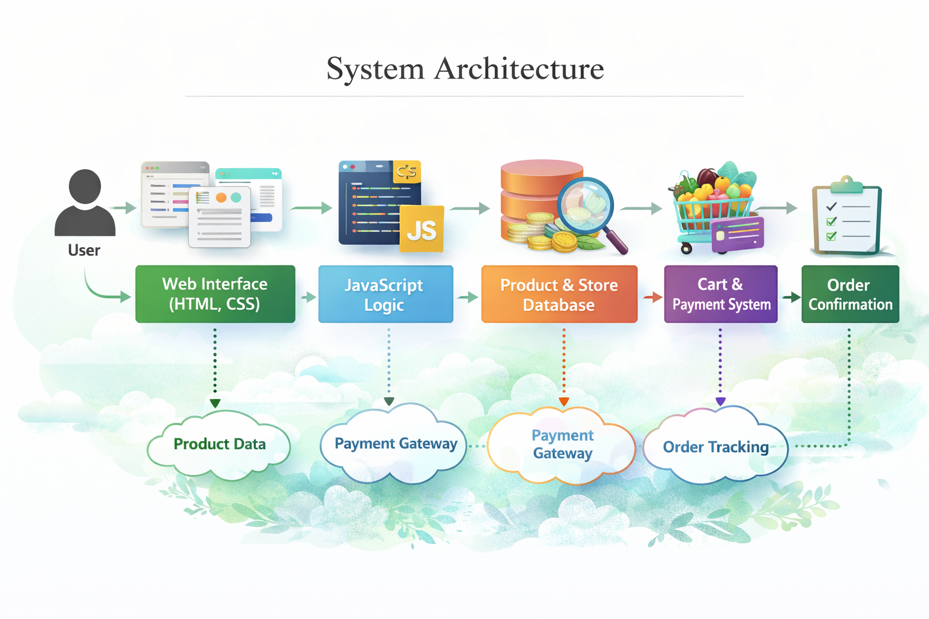

Slide 8
Project Modules
1.User Registration and Login Module
Allows users to create an account and log in to the system.
Stores user details securely in the database.
2. Product Management Module
Displays different grocery items available in the system.
Organizes products into categories like fruits, vegetables, dairy, and grains.
3. Store Management Module
Stores information about different grocery stores.
Maintains product prices and availability for each store.

Slide 9
4. Price Comparison Module
Compares prices of the same product from multiple stores.
Helps users choose the store with the lowest price.
5. Cart Management Module
Users can add or remove products from the cart.
Shows total cost of selected items.
6. Order and Payment Module
Allows users to place orders.
Supports payment methods like UPI, card payment, and cash on delivery.

Slide 10
Objectives
To develop a platform that allows users to compare grocery prices from multiple nearby stores.
To help customers find the best deals and save money on grocery purchases.
To reduce the time and effort required for visiting different stores to check prices.
To provide an easy and user-friendly interface for searching and selecting grocery items.
To allow users to add products to a cart and calculate the total cost before purchasing.
To support multiple payment options for convenient transactions.
To improve the shopping experience by providing transparent price information.

Slide 11
Co’s Attainments - FWD
1. CO1
Linear Search
Sorting Algorithms
Time Complexity
2. CO2
Singly Linked List
Dynamic Storage
Traversal
Node Management
3. CO3
Stack
Priority Queue
Prioritized Processing

Slide 12
4. CO4
Product Database
Java Collections
Nested Mapping(Tree Map, HashMap)
5. CO5
Data Integrity
System Integration
Safe Input Handling

Slide 13
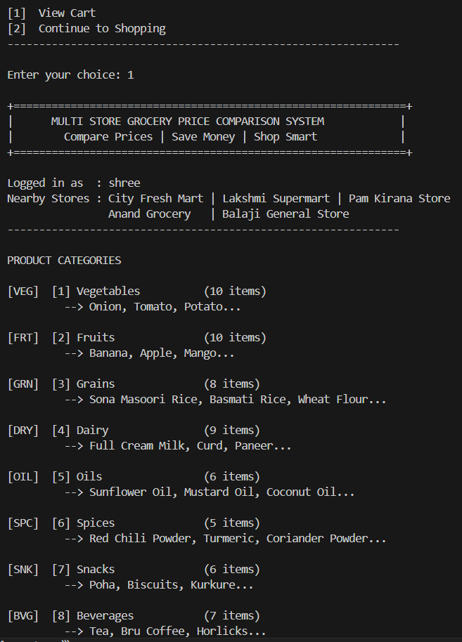
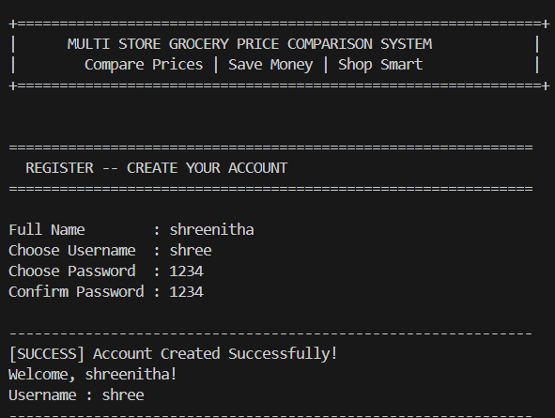
Screenshots for DSA

Slide 14
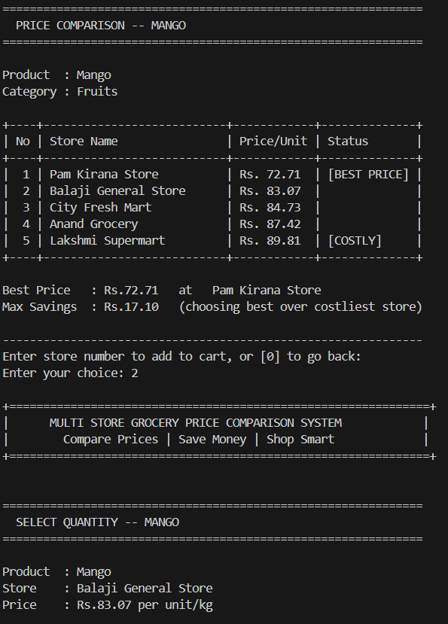
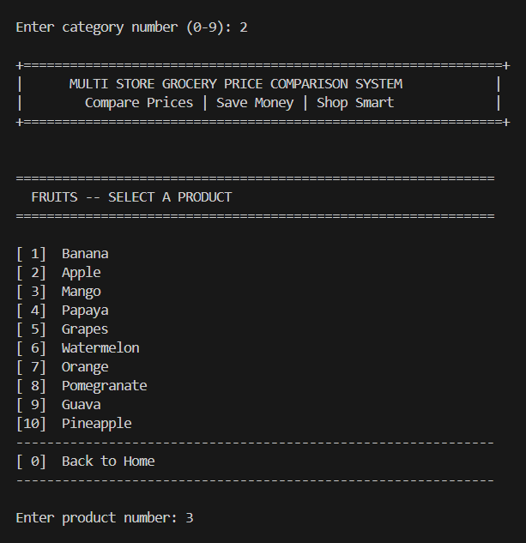

Slide 15
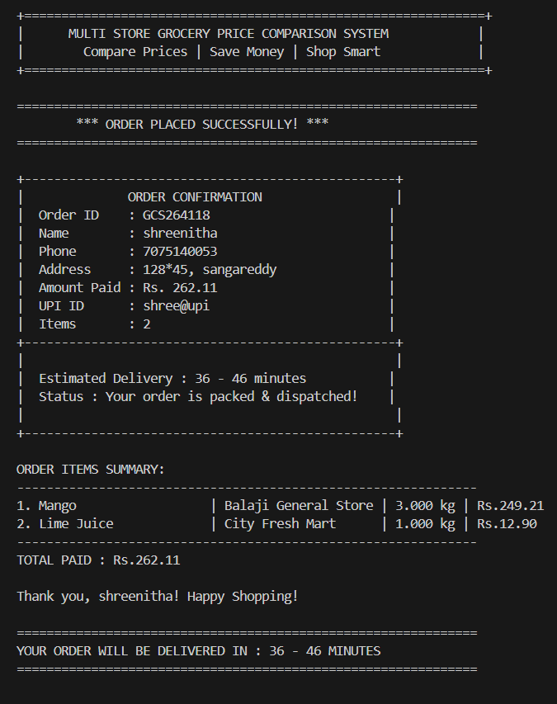
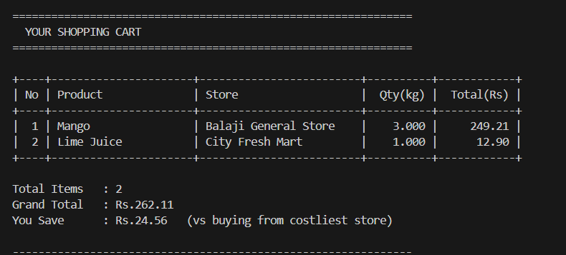

Slide 16
Conclusion
The Grocery Compare system is designed to make grocery shopping easier and more convenient for customers. It allows users to compare the prices of grocery products from multiple stores in one place, helping them choose the best and most affordable options. This system reduces the time and effort required to visit different stores and manually check prices.
By providing features such as product search, price comparison, and cart management, the system improves the overall shopping experience. The project demonstrates how technology can simplify daily activities and help customers save both time and money while making smarter purchasing decisions.

Slide 17
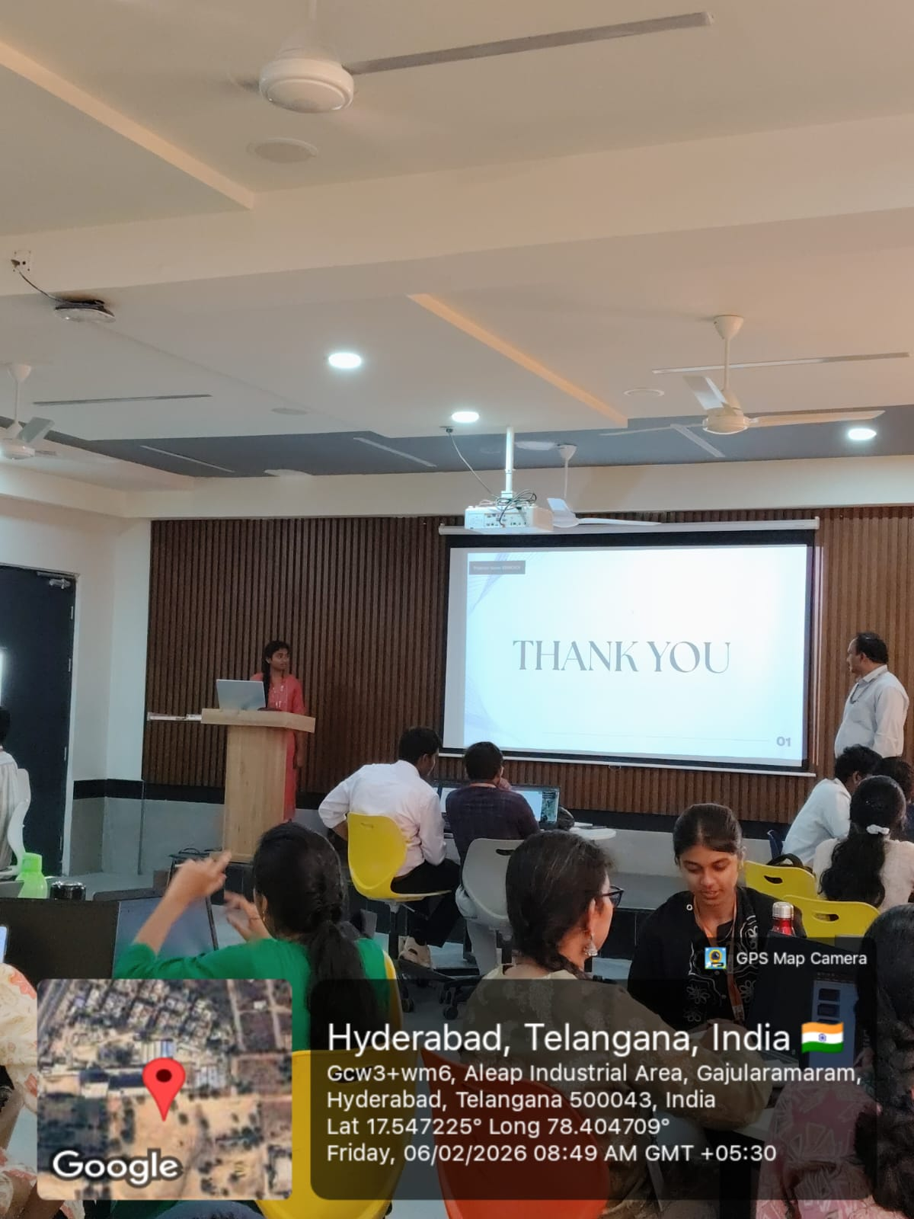
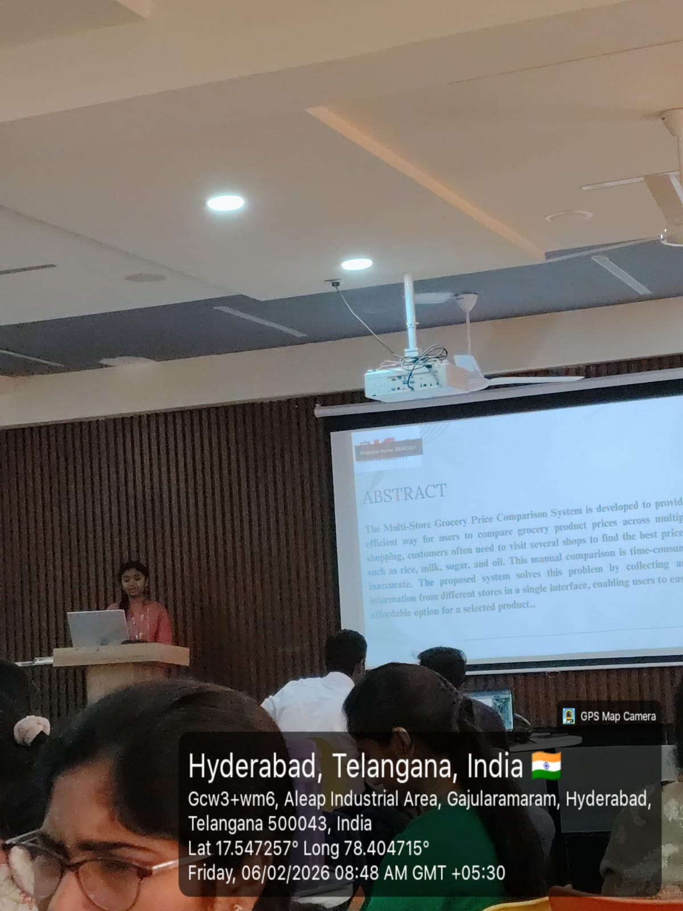
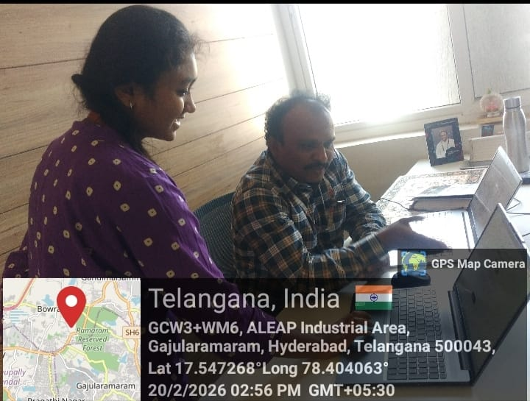
Geo- Tag Photos

Slide 18
THANK YOU

